Slide 1
LPC 2148 - PWM

Slide 2

Introduction
Pulse Width Modulation (PWM) is a technique by which width of a pulse is varied while keeping the frequency constant.
A period of a pulse consists of an ON cycle (HIGH) and an OFF cycle (LOW). The fraction for which the signal is ON over a period is known as duty cycle.
Duty Cycle (In %) = x 100
E.g. Consider a pulse with a period of 10ms which remains ON (high) for 2ms.The duty cycle of this pulse will be D = (2ms / 10ms) x 100 = 20%
Through PWM technique, we can control the power delivered to the load by using ON-OFF signal.

Slide 3
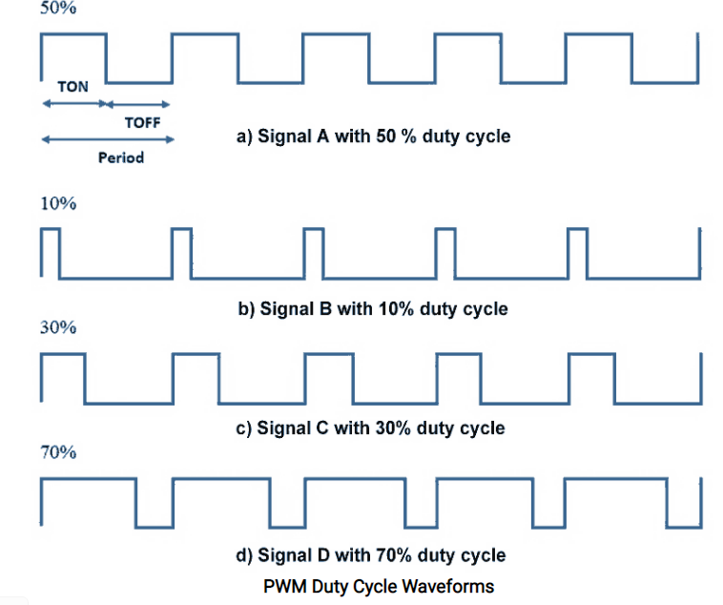
Pulse Width Modulated signals with different duty cycle are shown below.

Slide 4
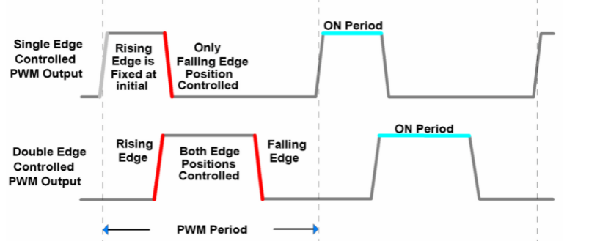
LPC2148 has PWM peripheral through which we can generate multiple PWM signals on PWM pins. Also, LPC2148 supports two types of controlled PWM outputs as,
Single Edge Controlled PWM Output Only falling edge position can be controlled.
Double Edge Controlled PWM Output Both Rising and Falling edge positions can be controlled.

Slide 5
Single Edge Controlled PWM : All the rising (positive going) edges of the output waveform are positioned/fixed at the beginning of the PWM period. Only falling (negative going) edge position can be controlled to vary the pulse width of PWM.
Double Edge Controlled PWM : All the rising (positive going) and falling (negative going) edge positions can be controlled to vary the pulse width of PWM. Both the rising as well as the falling edges can be positioned anywhere in the PWM period.

Slide 6
LPC2148 PWM
The PWM in LPC2148 is based on standard 32-bit Timer Counter, i.e. PWMTC (PWM Timer Counter). This Timer Counter counts the cycles of peripheral clock (PCLK).
Also, we can scale this timer clock counts using 32-bit PWM Prescale Register (PWMPR).
LPC2148 has 7 PWM match registers (PWMMR0 – PWMMR06).
One match register (PWMMR0) is used to set PWM frequency.
Remaining 6 match registers are used to set PWM width for 6 different PWM signals in Single Edge Controlled PWM or 3 different PWM signals in Double Edge Controlled PWM.
Whenever PWM Timer Counter (PWMTC) matches with these Match Registers then, PWM Timer Counter resets, or stops, or generates match interrupt, depending upon settings in PWM Match Control Register(PWMMCR).

Slide 7
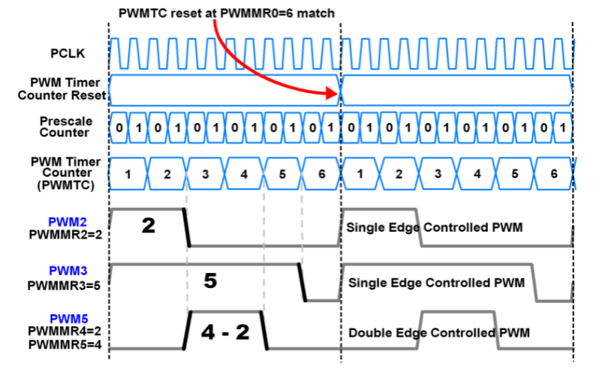

Slide 8
As shown in above figure, PWMMR0 = 6 i.e. PWM period is 6 counts, after which PWM Timer Counter resets.
PWM2 & PWM3 are configured as Single Edge Controlled PWM and PWM5 is configured as Double Edge Controlled PWM.
Prescaler is set to increment PWM Timer Counter after every two Peripheral clocks (PCLK).
Match registers (PWMMR2 & PWMMR3) are used to set falling edge position for PWM2 & PWM3.
PWMMR4 & PWMMR5 are used to set rising & falling edge positions respectively for PWM5.

Slide 9
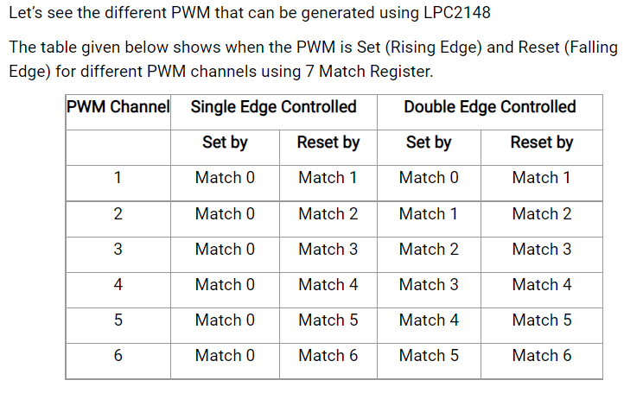

Slide 10
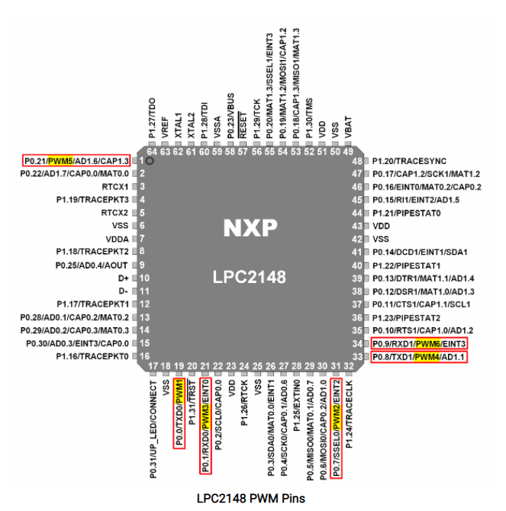
PWM Pins

Slide 11
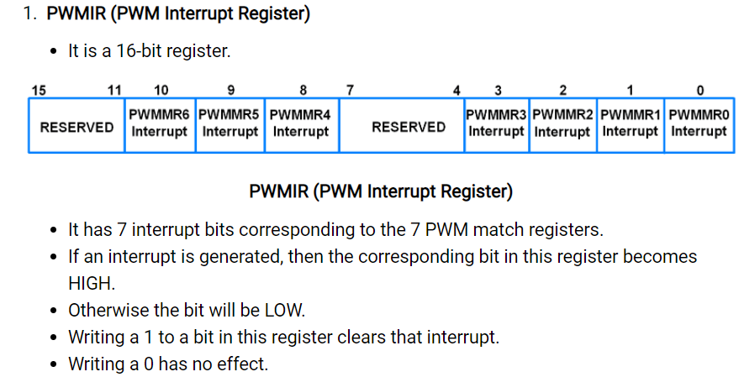
PWM Registers

Slide 12
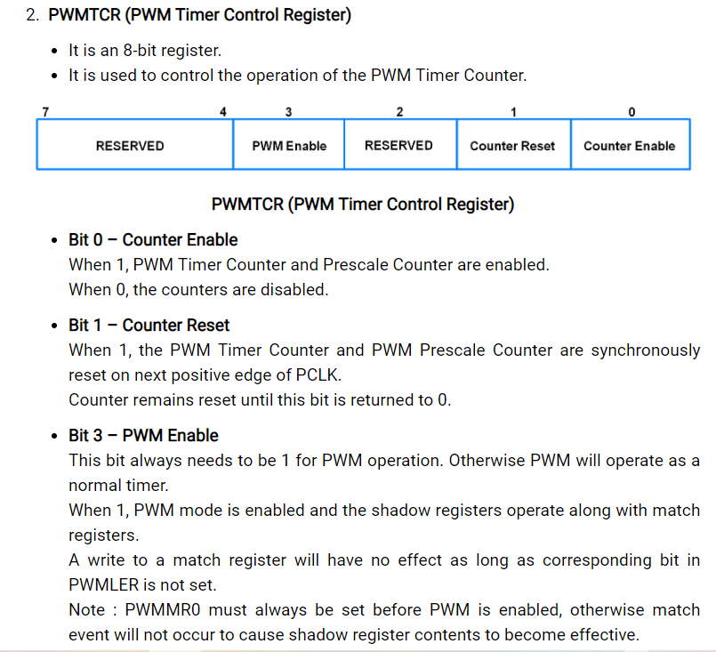

Slide 13
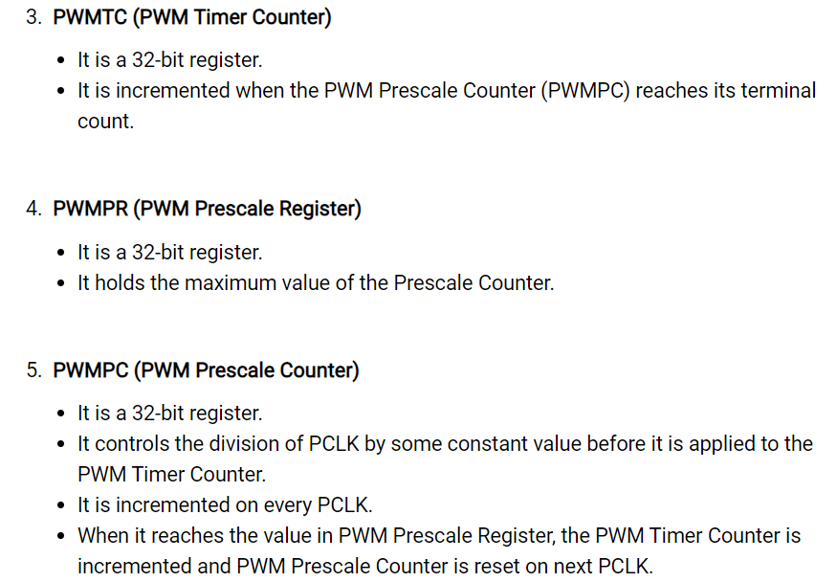

Slide 14
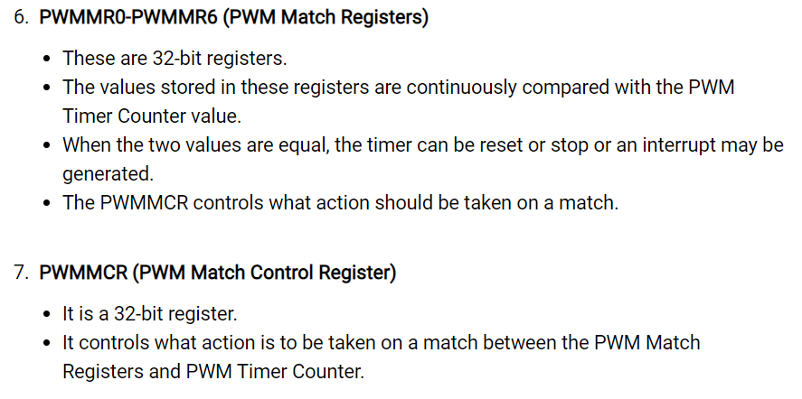

Slide 15
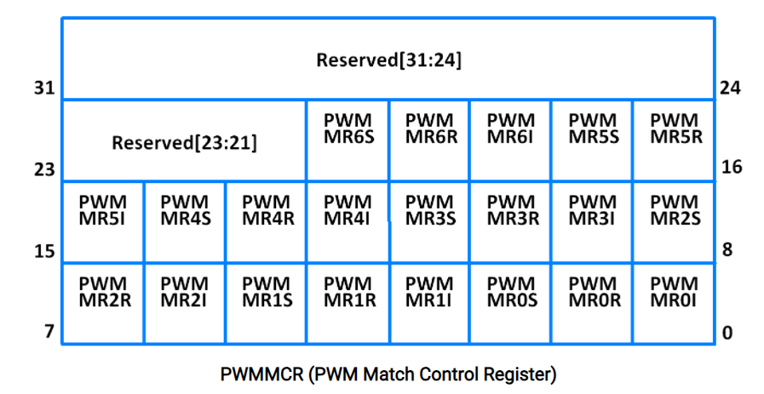
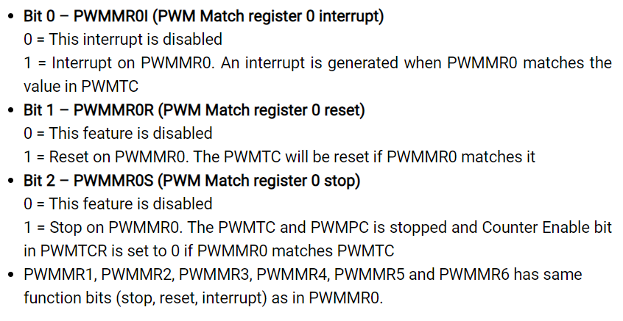

Slide 16
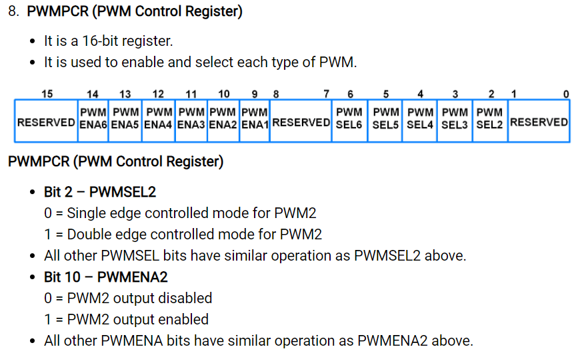

Slide 17
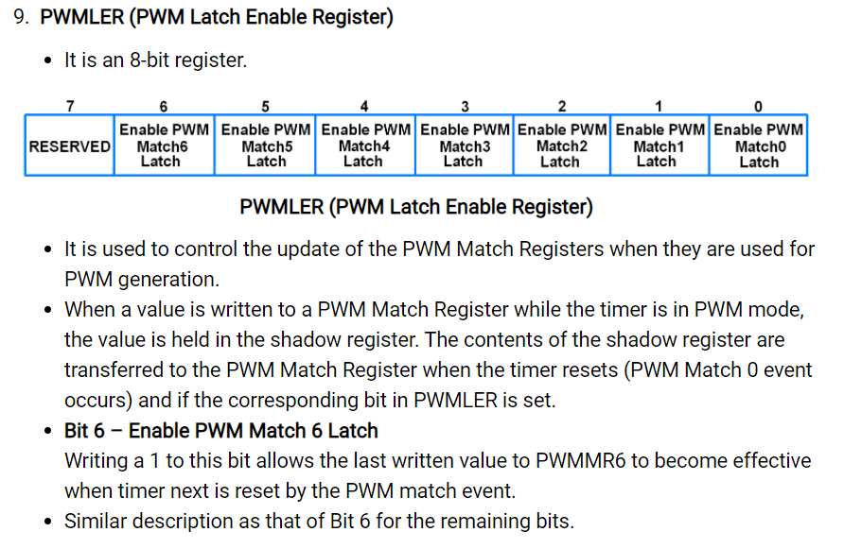

Slide 18
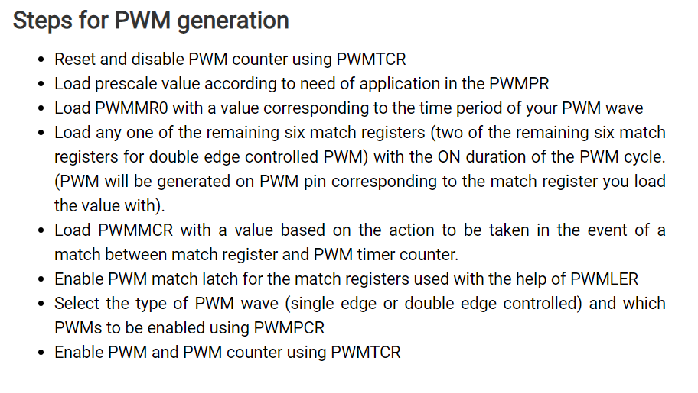

Slide 19
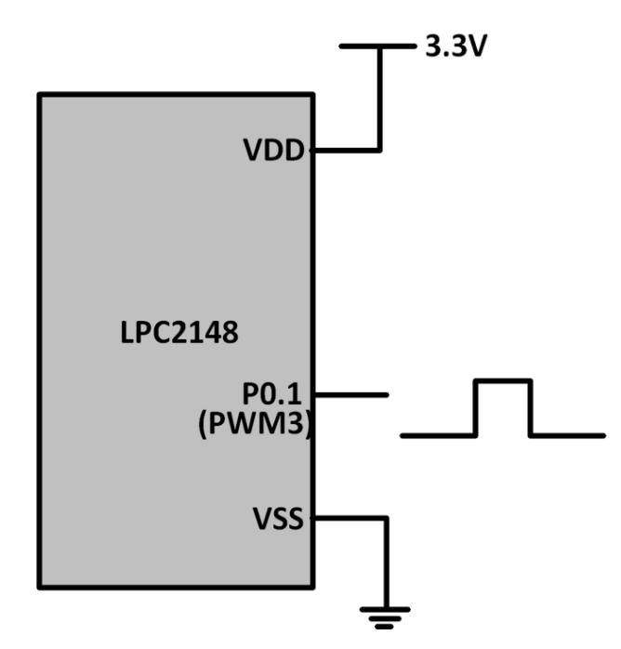
Program: Let’s write a Program to generate a double edge controlled PWM on PWM3 (P0.1).
#include <lpc214x.h>
__irq void PWM_ISR (void)
{
if ( PWMIR & 0x0001 ) /* If interrupt due to PWM0 */
{
PWMIR = 0x0001; /* Clear PWM0 interrupt */
}
if ( PWMIR & 0x0002 ) /* If interrupt due to PWM1 */
{
PWMIR = 0x0002; /* Clear PWM1 interrupt */
}
if ( PWMIR & 0x0004 ) /* If interrupt due to PWM2 */
{
PWMIR = 0x0004; /* Clear PWM2 interrupt */
}
if ( PWMIR & 0x0008 ) /* If interrupt due to PWM3 */
{
PWMIR = 0x0008; /* Clear PWM3 interrupt */
}
VICVectAddr = 0x00000000;
}

Slide 20
int main (void)
{
VPBDIV = 0x00000002;
PINSEL0 = PINSEL0 | 0x00008008; /* Configure P0.1 and P0.7 as PWM3 and PWM2 respectively */
VICVectAddr0 = (unsigned) PWM_ISR; /* PWM ISR Address */
VICVectCntl0 = (0x00000020 | 8); /* Enable PWM IRQ slot */
VICIntEnable = VICIntEnable | 0x00000100; /* Enable PWM interrupt */
VICIntSelect = VICIntSelect | 0x00000000; /* PWM configured as IRQ */ // For PWM3 double edge
PWMTCR = 0x02; /* Reset and disable counter for PWM */
PWMPR = 0x1D; /* Prescale value for 1usec, Pclk=30MHz*/
PWMMR0 = 100000; /* Time period of PWM wave, 100msec */
PWMMR2 = 40000; /* Rising edge of double edge controlled PWM */
PWMMR3 = 80000; /* Falling edge of double edge controlled PWM */
PWMMCR = 0x00000243; /* Reset and interrupt on MR0 match, interrupt on MR2 and MR3 match */
PWMLER = 0x0D; /* Latch enable for PWM3, PWM2 and PWM0 */
PWMPCR = 0x0C08; /* Enable PWM3, PWM2 and PWM0, double edge controlled PWM on PWM3 */
PWMTCR = 0x09; /* Enable PWM and counter */
while (1); }

Slide 21
Thank You

